Slide 1
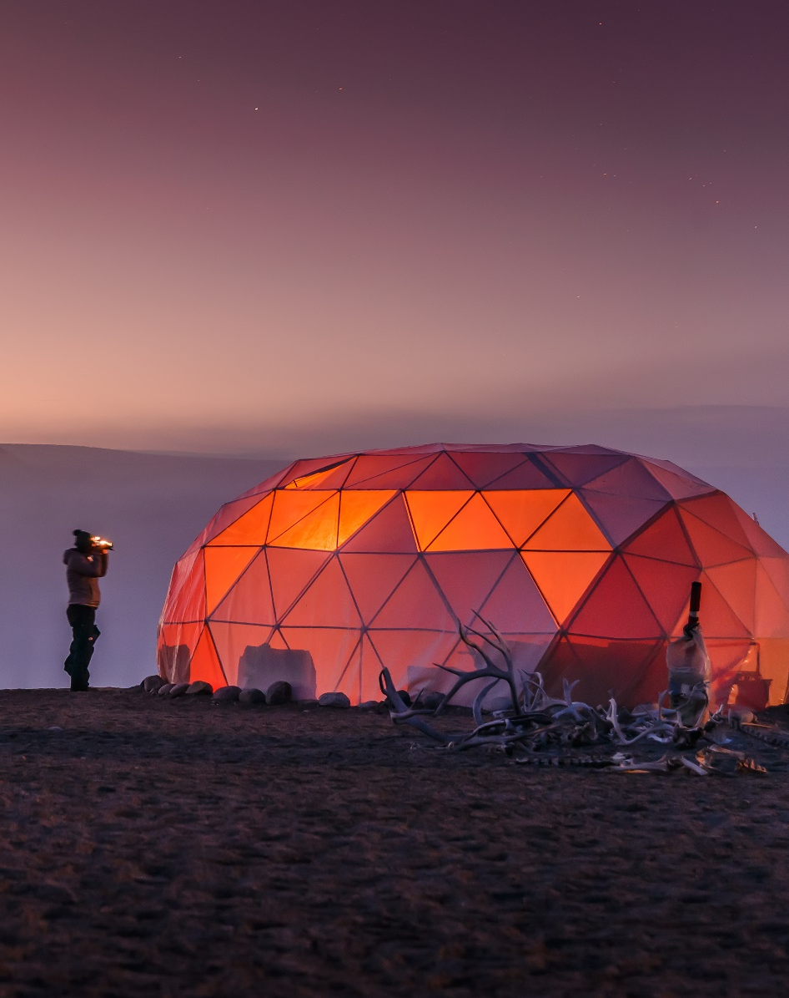


Part I Warm Up
The Night
Answer these questions with a partner.
Look at the picture. Would you like to sleep in a place like this?
Are you a “morning person” or a “night person”? Why?
What do you usually do in your spare time at night?
Lit-up dome tents at Qaleraliq Glacier Camp, near Narsaq, Greenland

Slide 2
Content Note
Qaleraliq Glacier Camp is located in Greenland, situated on the edge of a massive glacier. The camp, which consists of a series of dome tents, offers breathtaking views of the surrounding landscape, with towering ice formations and snow-capped mountains in every direction. Visitors to the camp can enjoy a range of activities, including hiking, glacier trekking, and kayaking in the nearby fjords. The camp is also home to a variety of wildlife, including polar bears, arctic foxes, and seals.
Each dome tent at Qaleraliq Glacier Camp is furnished with four bunk beds, a small table, and a chair. While the dome tents are unheated, guests at the camp are provided with warm sleeping bags. Food is provided in longer dome tents at the camp, and restroom facilities are provided as outhouses at the furthest ends of the camp.
With its rugged beauty and remote location, Qaleraliq Glacier Camp is the perfect destination for adventure travelers in one of the world’s most stunning natural landscapes.

Slide 3
Language Note
The terms morning person and night person refer to when a person generally feels most active and alert during the day.
A morning person wakes up early and feels most energetic in the morning. These people usually get a lot done in the morning and start to slow down later in the day.
A night person is the opposite: slow and tired in the morning, but active at night and often awake quite late.
A person’s type may change depending on age and life circumstances. Many young people are more awake at night, while many older people prefer mornings. The terms early bird and night owl are also used.

